Slide 1


Image Defogging
Reporter：王忠安
Date：2021.12.27
Group 14：王忠安 石帅 魏雪齐

Slide 2

Introduction
Defogging
Defogging is highly desired in consumer/computational photography and computer vision applications.
Removing fog can significantly increase the visibility of the scene and correct the color shift caused by the airlight.

Slide 3

Methods
1
Dark Channel Prior
2
Feature Fusion Attention Network

Slide 4
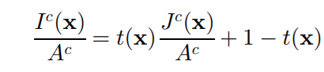
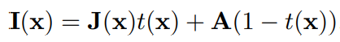
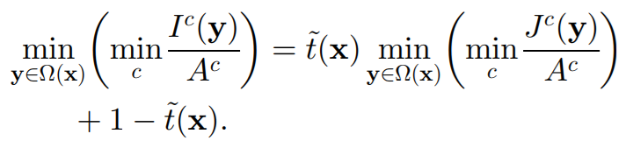
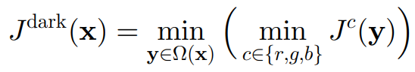
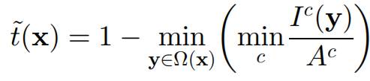
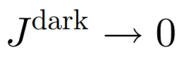
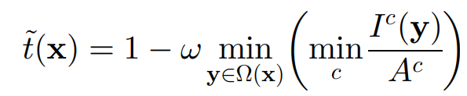
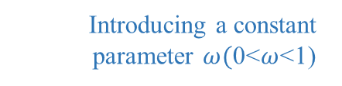
Dark Channel Prior
The model：
Assume that A is given and t(x) is constant：
Dark channel：
Put the minimum operators
Due to the dark channel prior
Dark channel prior：
Introducing a constant parameter $ω($0<$ω$<1)

Slide 5
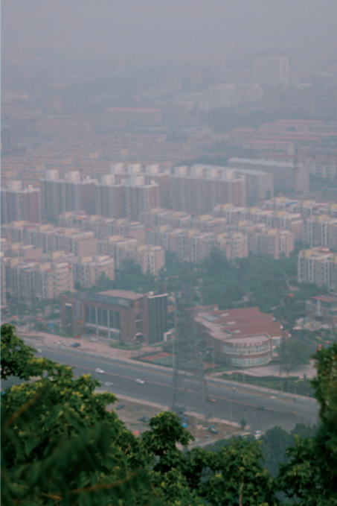
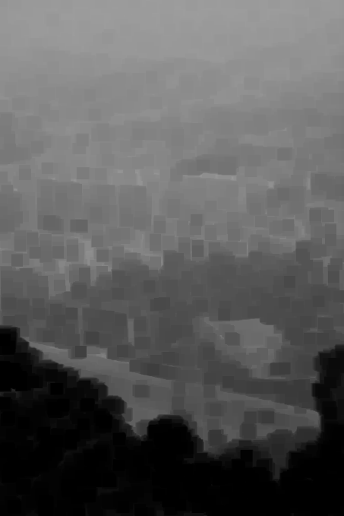
Dark Channel Prior
City_fog
Dark Channel

Slide 6
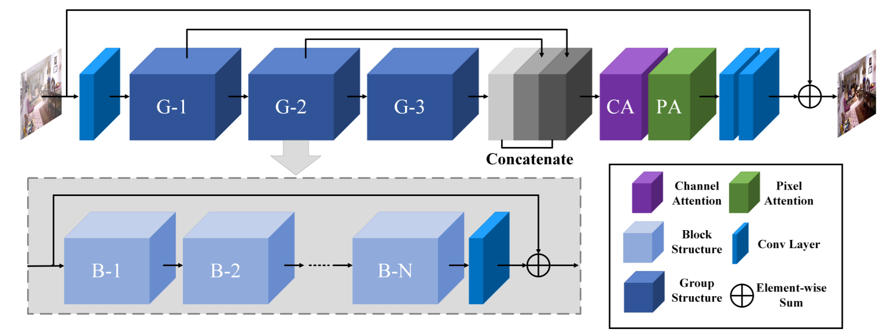
Feature Fusion Attention Network
FFA-Net architecture：

Slide 7
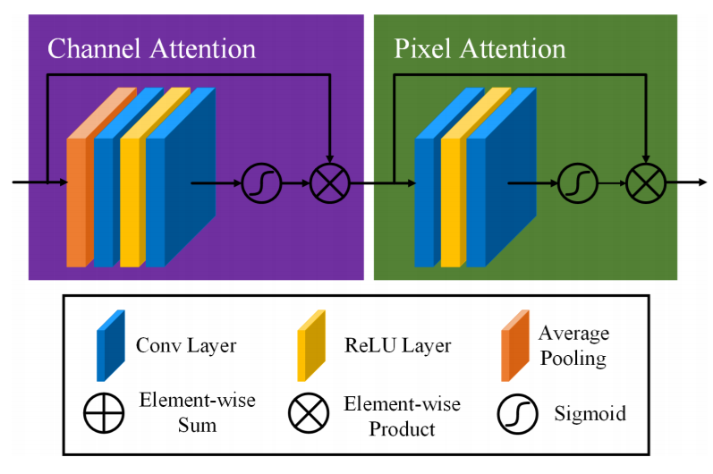
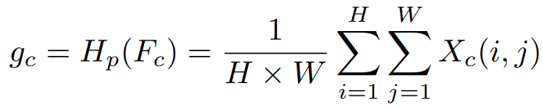
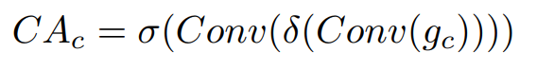
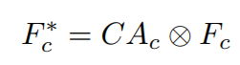
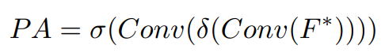
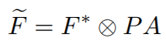
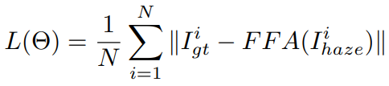
Feature Fusion Attention Network
Feature Attention module：
Channel Attention：
Global average pooling:
Pass through two convolution layers and sigmoid, ReLu activation function latter:
Element-wise multiply the input Fc and the weights of the channel CAc:
Pixel Attention ：
Similar to CA:
Loss Function:

Slide 8

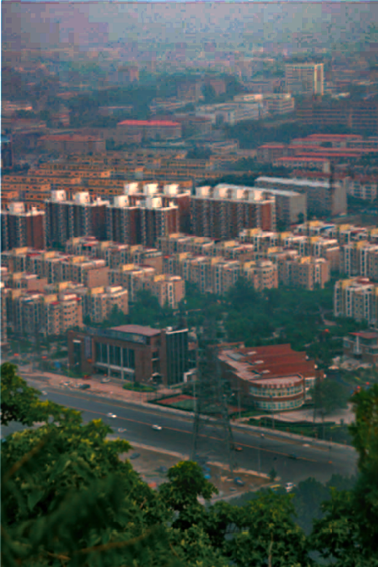
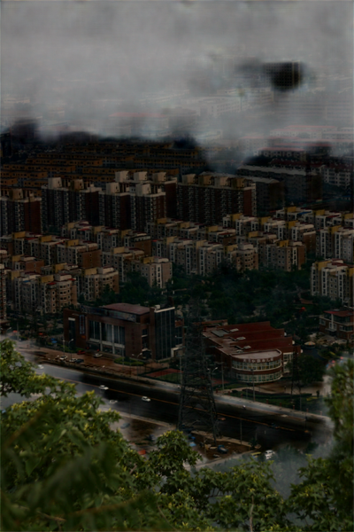
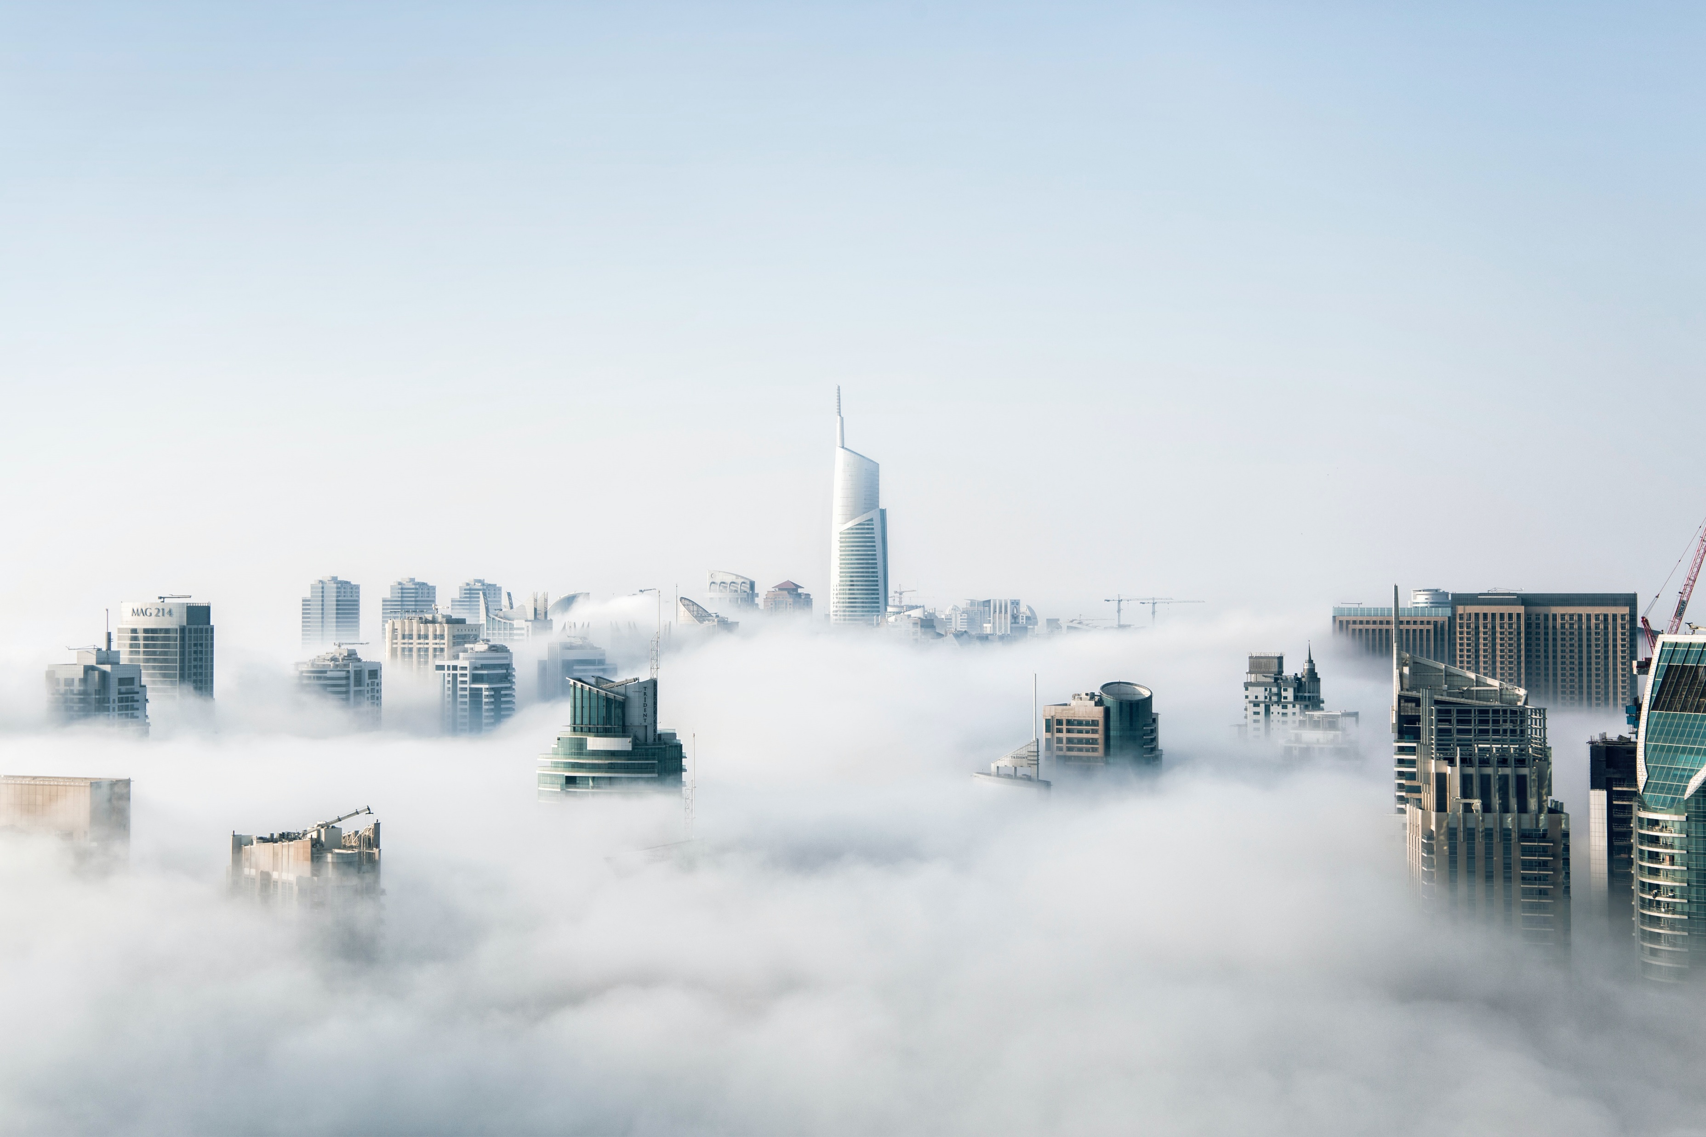
Result
City_fog
Source
DCP
FFA

Slide 9
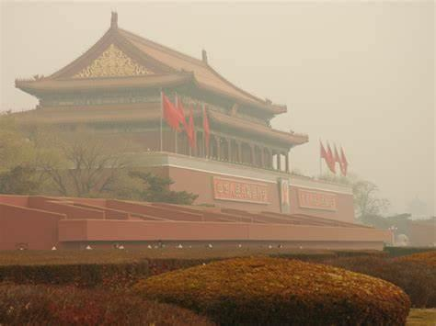
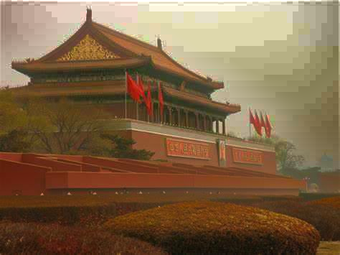
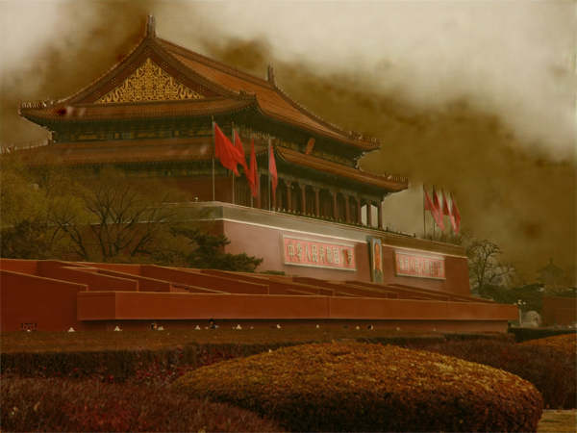
Result
Square_fog
Source
DCP
FFA

Slide 10
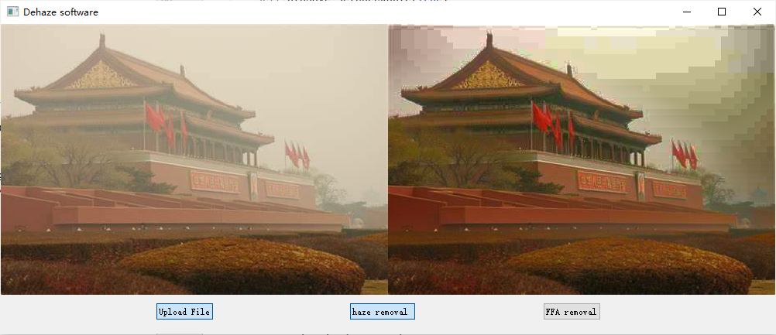



Application
Upload File
haze removal
FFA removal
Select original image with fog
Dark Channel Prior Method
Feature Fusion Attention Network

Slide 11
Thanks

